Slide 1
Migration of Labview into the Test of magnetic Properties
Supervisor: Prof. Dr.-Ing H. Förschner
07.11.26

Slide 2
Contents
Project (Task)
Current state
Next steps
Technical challenges
Benefits of the project
Hochschule Esslingen

Slide 3
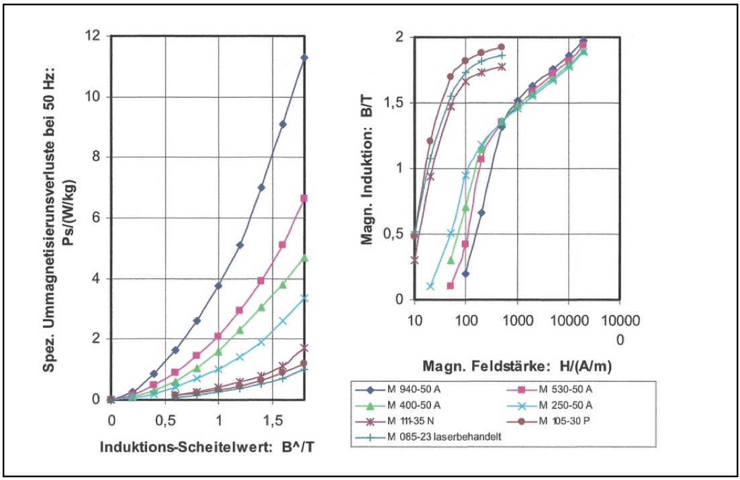
Project (Task)
Test of magnetic properties
Transfer of the old system into a new system
Implementation in LabView
Optimize the system regarding controlling and visualization
Hochschule Esslingen

Slide 4
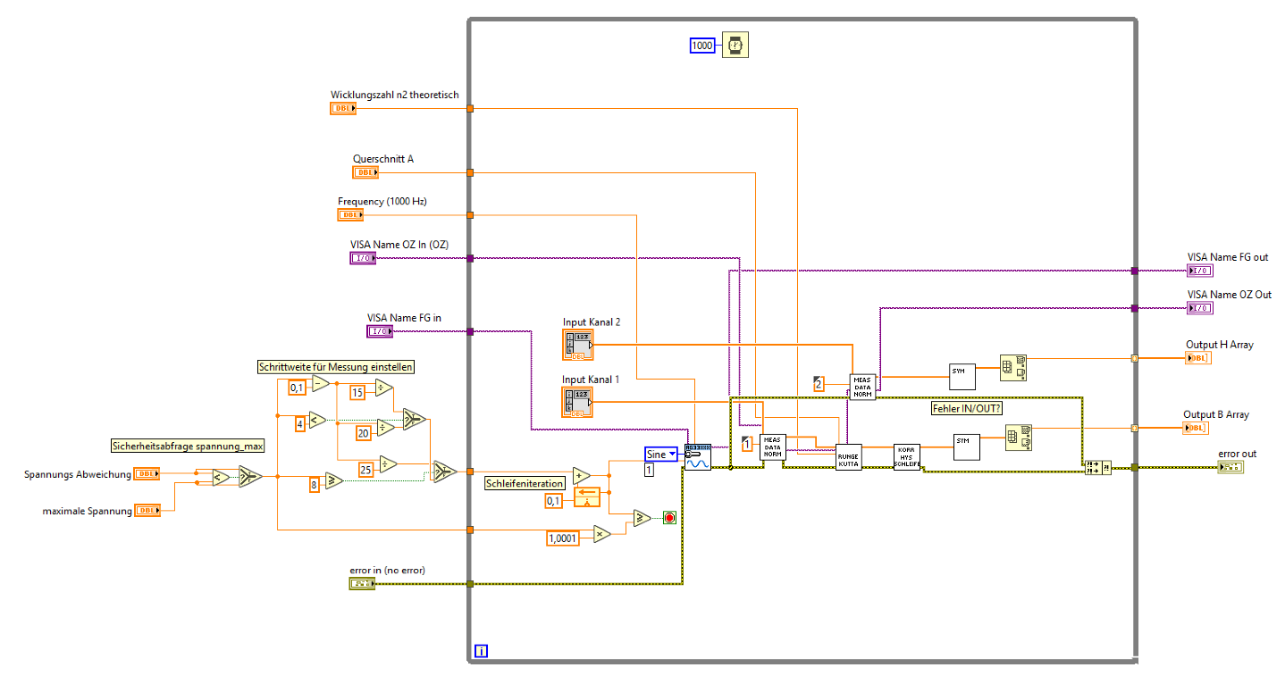
Current state
Software-Hardware-Comunication is finished
Translation of the old Pascal-Code to LabView-Code is in process
Single software modules are already tested
Hochschule Esslingen

Slide 5
Next steps
Finish the migration into LabView
Testing (of all single software modules)
Implementation of a state machine
Testing with „real“ Hardware
Optimization
Hochschule Esslingen

Slide 6
Challenges
Technical:
Learning/Understanding of new programming languages
  LabView
  Pascal
Hardware communication
  Importing measurement data
Generating plots with LabView
Hochschule Esslingen

Slide 7
Challenges
As a Team:
Working in a complex project
  Communication
  Organisation and distribution of the work loads
Hochschule Esslingen

Slide 8
Benefits of the project
Learning of new programing languages
  Pascal
  LabView
Software development in a Team
  Development with SCRUM
  Team management (Trello etc.)
Hochschule Esslingen

Slide 9
Thank you

